Slide 1
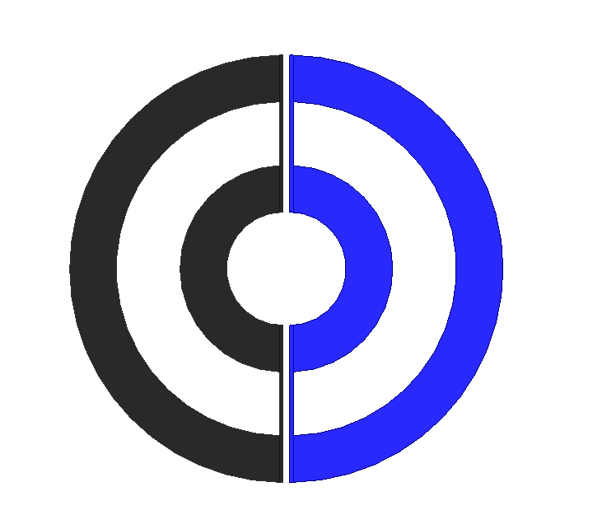
Tx1
Tx2
Constant Flux Region

Slide 2
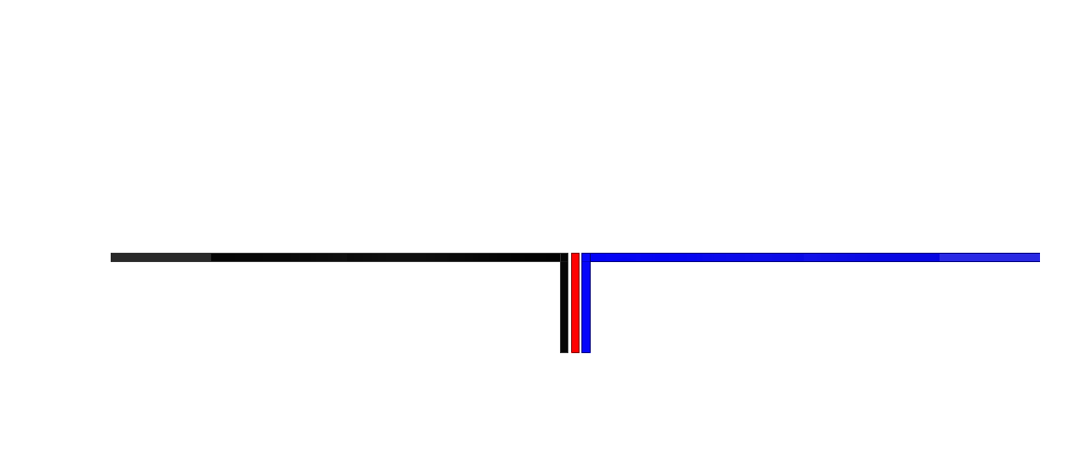
Tx1
Tx2
Ferrite

Slide 3
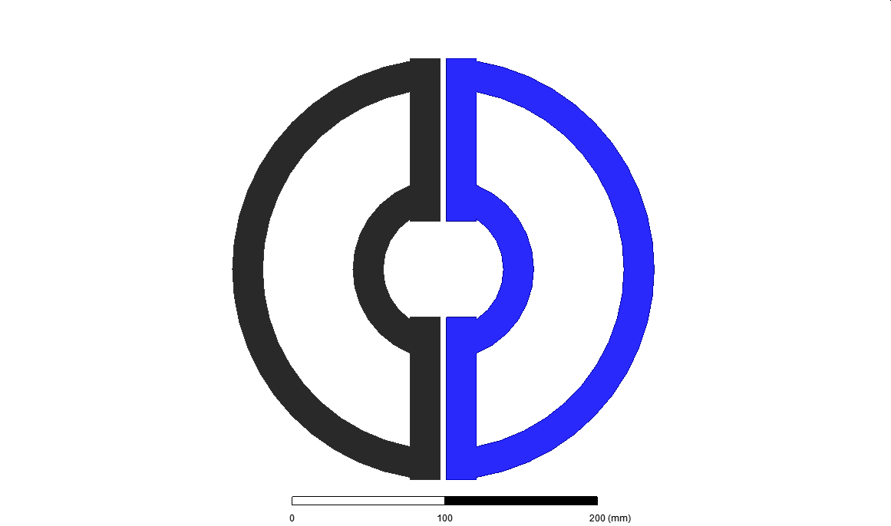
Distorted Flux Region
Tx1
Tx2
Constant Flux Region

Slide 6
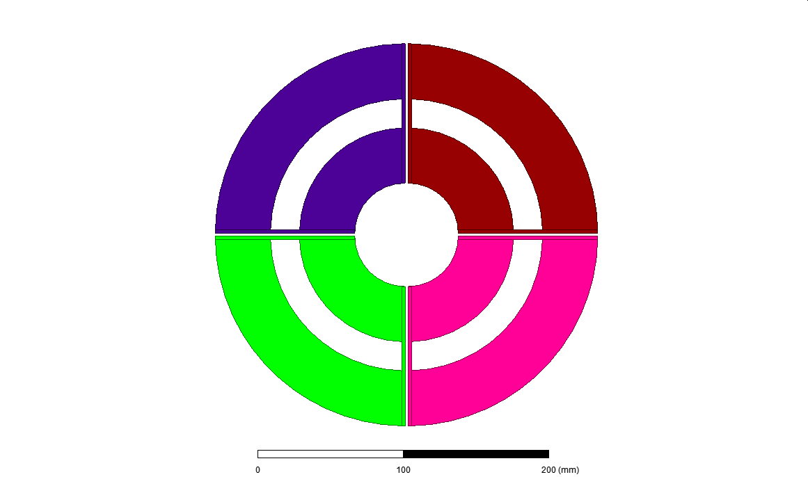

Slide 7
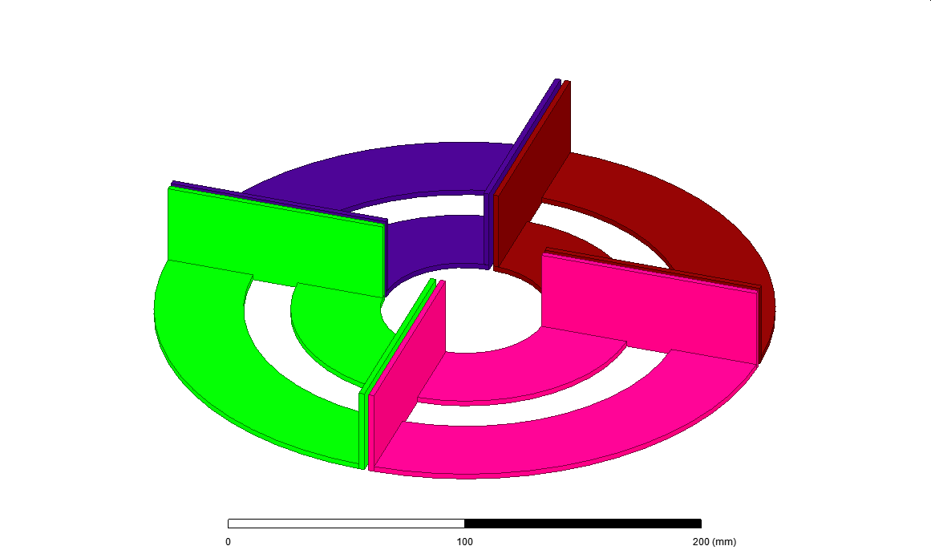

Slide 8
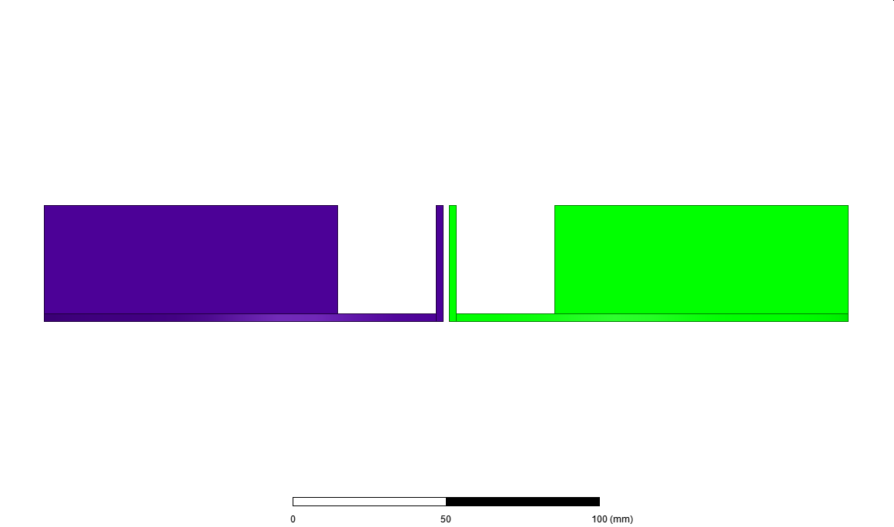

Slide 9
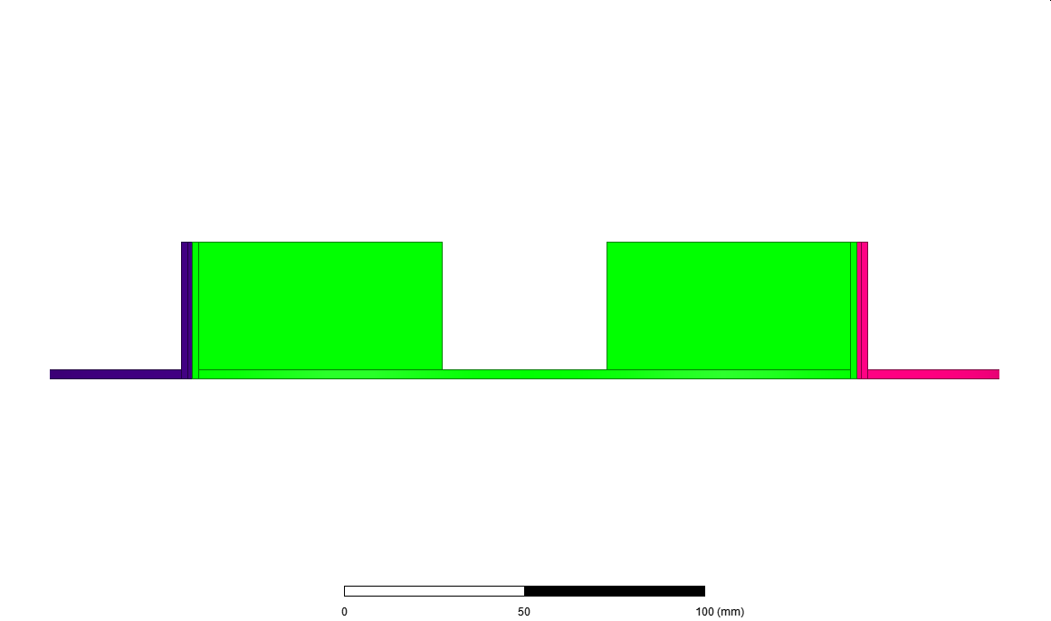

Slide 11
Rx2
/
/
Rx3
/
/
/
/
/
/
/
/
/
/
/
/
Rx1
/
/
Rx4
Main Flux Region

Slide 13
Rx4
Rx1
Cross-Coupling Region

Slide 15
Rx2
Rx3
Rx1
Rx4

